Slide 1

Locations to Open Asian Restaurants in Edmonton
By David Hyun Jun Shim

Slide 2
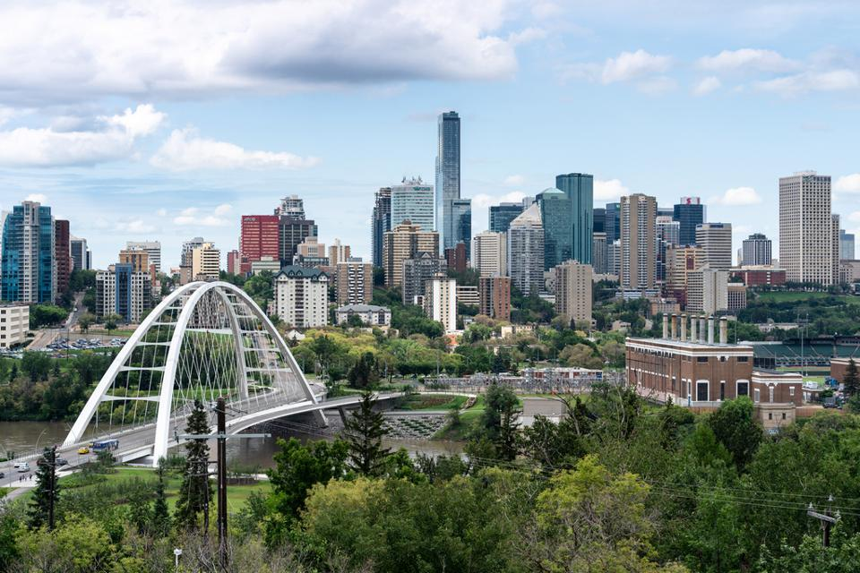
Capital City of Alberta
1.5million population
2nd largest city in Alberta
5th largest municipality in Canada
Edmonton
Ref: https://www.forbes.com/sites/sandramacgregor/2020/01/09/discover-why-edmonton-is-one-of-canadas-hottest-destinations/?sh=293baf574967

Slide 3
Business Problem
Majority of Asian immigrants in Edmonton choose to open their restaurant business.
Determine perfect locations for immigrant Asians to open their Asian restaurants.

Slide 4
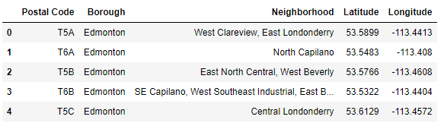
Data
Collect the data from Wikipedia:
https://en.wikipedia.org/wiki/List_of_postal_codes_of_Canada:_T’

Slide 5
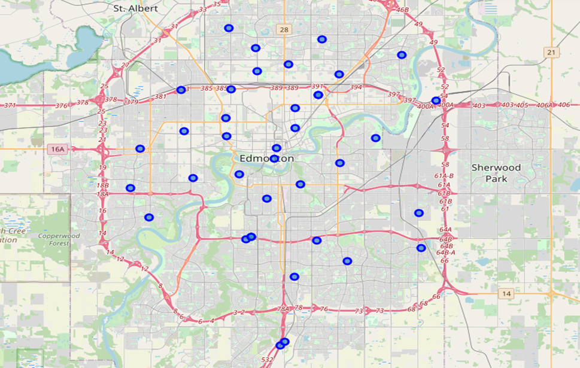
Data
Edmonton Neighborhood Map created using Folium package

Slide 6
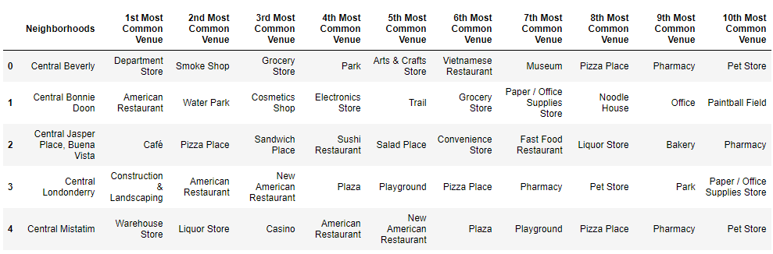
Methodology
Using Foursquare API, collect a list of venues and its categories around each neighborhood.
Group rows by neighborhood and by taking means of the frequency of occurrence of each category
Print top ten common venues for each neighborhood.

Slide 7
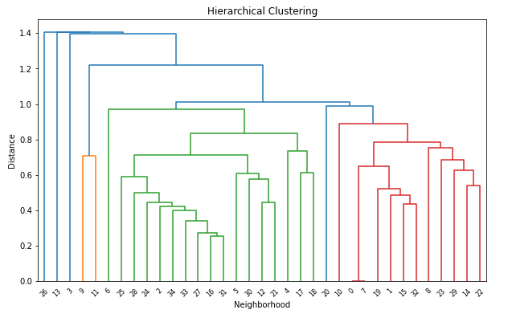
Methodology
Hierarchical Clustering
Based on the diagram, we choose cluster number 6 for k-means clustering.
We cut off at distance=1.0 to figure the proper cluster label.

Slide 8
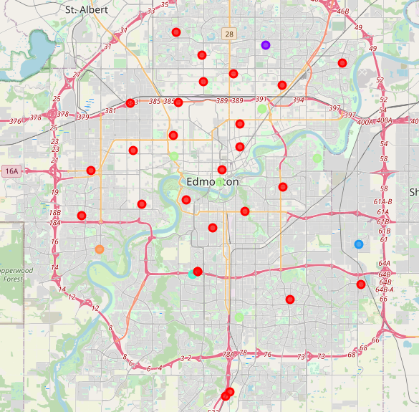
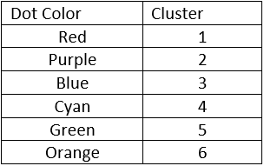
Results and Discussion
Map created using Folium package
Grouped based on six clusters.

Slide 9
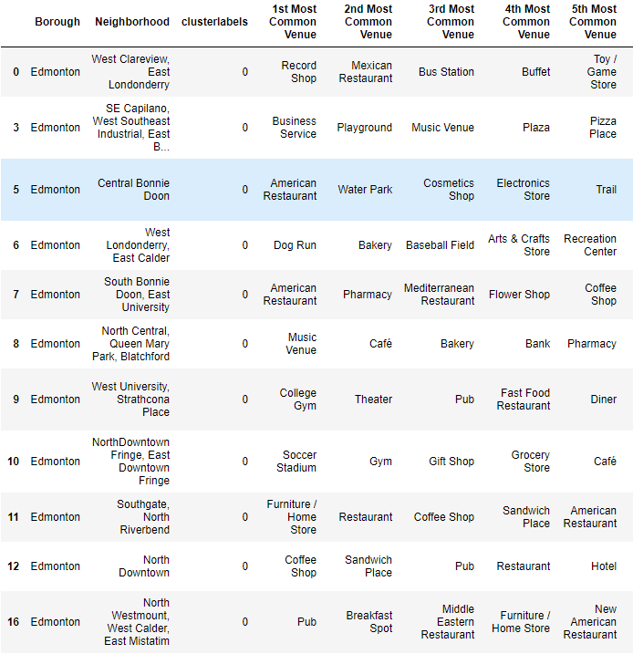
Results and Discussion
Cluster 1
Central Bonnie Doon(5): American Restaurant (1st most common venue)
South Bonnie Doon(7): American Restaurant (1st most common venue) Mediterranean (3rd most common venue)

Slide 10
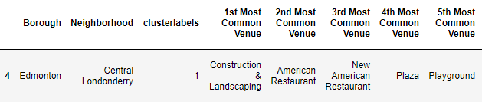
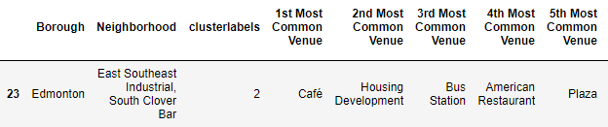
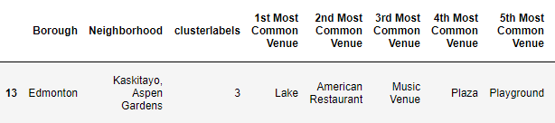
Results and Discussion
Cluster 2
Central Londonderry(4): American Restaurant (2nd and 3rd most common venue)
Cluster 3
Not much restaurants around
Cluster 4
Kaskitayo(13):
American Restaurant
(2nd most common venue)

Slide 11
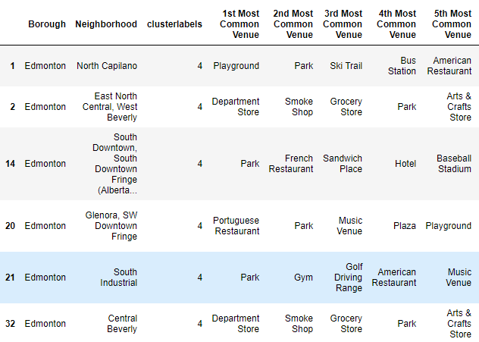
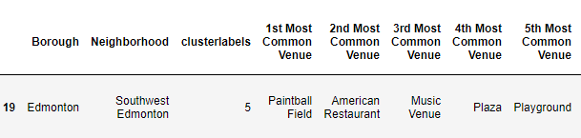
Results and Discussion
Cluster 5
Not Many Restaurants around.
Cluster 6
Southwest Edmonton (19):
(2nd most common venue)

Slide 12
Conclusion
Best Locations:
North Edmonton: Central Londonderry
South Edmonton: Southwest Edmonton, Kaskitayo
Central Edmonton: Bonnie Doon

Slide 13
Thank You!!!

